Slide 1
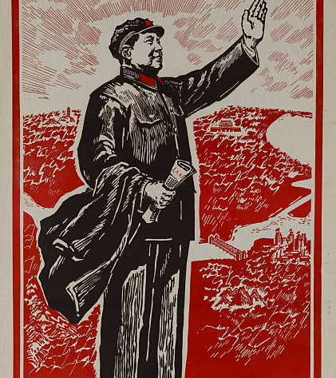
Module 3
The End of the Cultural Revolution 1972-1989

Slide 2
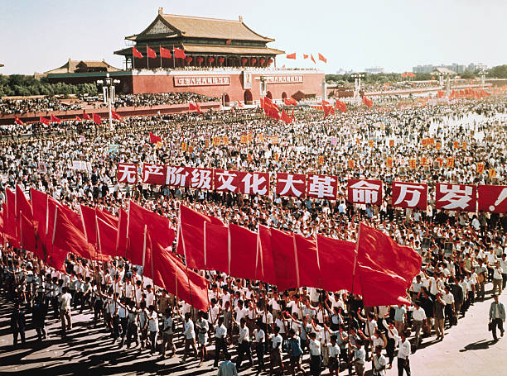
Major Questions:
What was the Cultural Revolution?
Who was responsible for the Cultural Revolution?
What were the origins of the Cultural Revolution?
What were the long-term consequences of the Cultural Revolution?

Slide 3
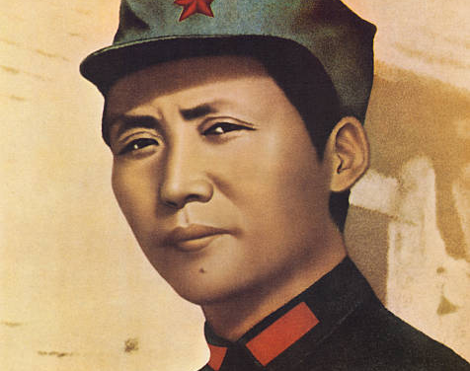
Module 3 Question:
How did the Cultural Revolution end and why did it end when it did?
Who was “officially” responsible for the cultural revolution and why?
Whose vision of China won out, Mao’s or his opponents?

Slide 4
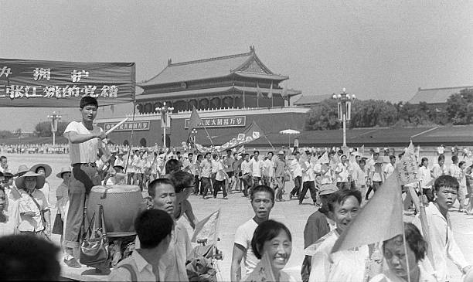
Module Theme
The Legacy of the Cultural Revolution

Slide 5
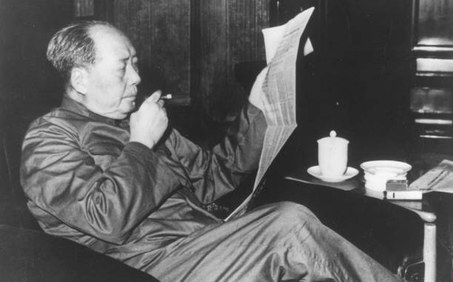
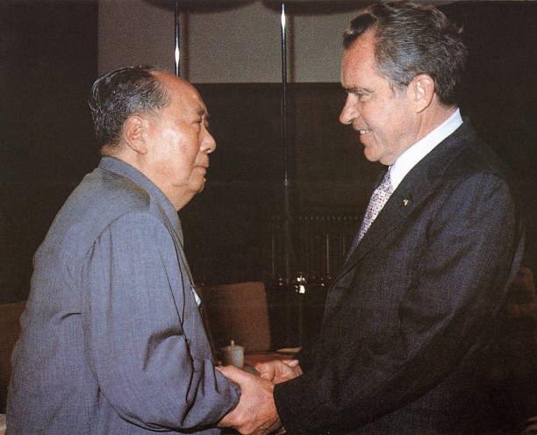
Signs of a “cooling” Revolution
Sino-US rapprochement
Nixon’s visit to China (February 1972)
Alongside the Soviet Union the U.S. was China’s greatest military and ideological enemy.
Mao Permits Deng Xiaoping to return
Returned to politics after working in a Jiangxi tire plant
Perhaps to spite his wife Jiang Qing
Mao’s Health
Increasingly feeble
80 in 1973
Diagnosed with congestive heart failure 1973 & Lou Gherigs disease in 1974

Slide 6
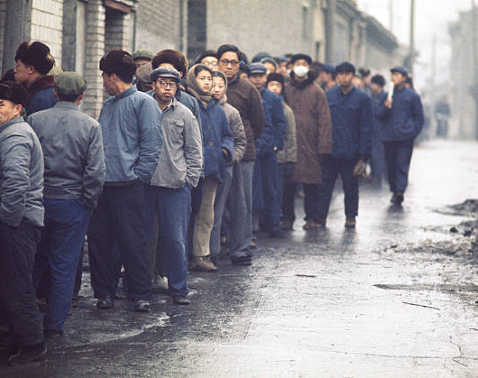
The Quieter Years (1973-1976)
Rebuilding the Party
By 1973 “pre-Cultural Revolution cadres were running the government ministries.”
Red Guard sent to the countryside
Often resented by farmers
Few useful skills & a sense of superiority
Lost education opportunities

Slide 7
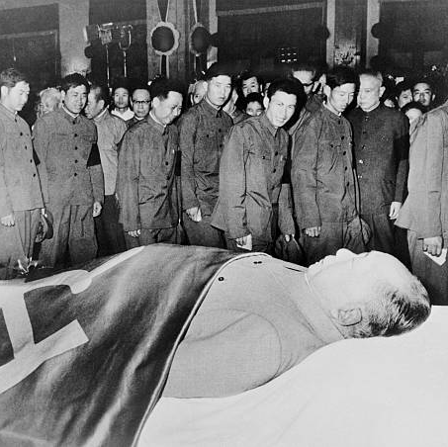
1976
Mao’s Death & the End of the Cultural Revolution
Death of Zhou Enlai (January 8, 1976)
Tangshan Earthquake (July 28, 1976)
At 3:42 AM
Magnitude 7.8
240,000 Deaths
Death of Mao (September 9, 1976)
The End of the Cultural Revolution
When Mao died he said the Cultural Revolution had few supporters and “quite a few opponents.” With the revolution unfinished in Mao’s mind he asks “What will happen to the next generation if it all fails?” “There will be a foul wind and a rain of blood. How will you cope? Heaven only knows!”

Slide 8
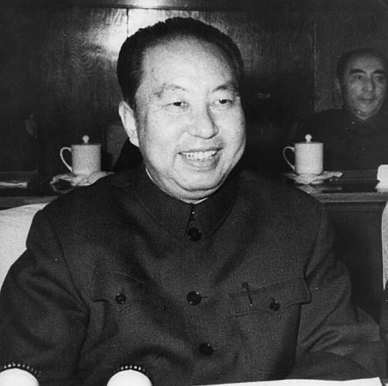
Mao’s Successor
Hua Guofeng (1976-1978)
Mao’s deathbed statement
“With you in charge, I am at ease,”
Presented as the political and ideological continuation of Mao with some deviations.
Promoted globalization
Western movies and literature now acceptable in China.
Began the process of rehabilitating China’s economy
Began 120 mammoth industrial projects

Slide 9
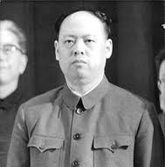
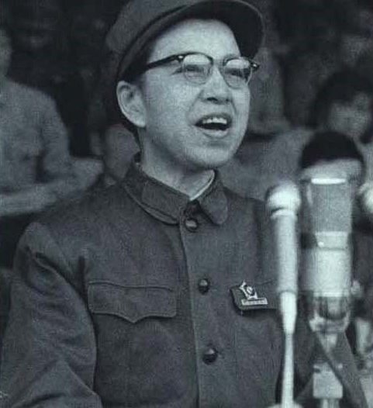
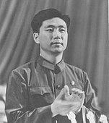
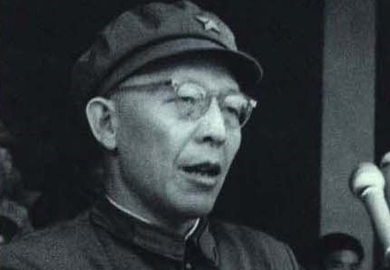
Making Sense of the Cultural Revolution
Four Patron’s of Mao & Key Figures in the Cultural Revolution
Yao Wenyuan
The Author of the Attack on Wu Han
Jiang Qing
Mao’s wife
Wang Hongwen
Zhang Chunqiao

Slide 10
Making Sense of the Cultural Revolution (Continued)
Blamed for the Cultural Revolution
“ Appearing to be leftist but actually rightist”
At trial years later
Accused of stealing state power and politically attacking 750,000 people resulting in nearly 35,000 deaths.
Jiang Qing & Zhang Chunqiao sentenced to death (later given life imprisonment).
Wang Hongwen & Yao Wenyuan sentenced to life.

Slide 11
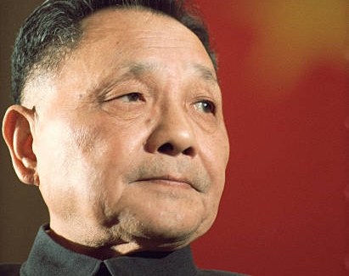
Breaking with the Past
Deng Xiaoping seizes power in 1978
Popular due to his positions and as an opponent of the Cultural Revolution
Policies a repudiation of radical Maoist policies
Capitalism and China’s Four Modernizations
“Doesn’t matter if it is a black cat or a white cat as long as it catches mice”
Agriculture. Industry, Technology, Defense
Special Economic Zones
Shenzhen
China’s Economic Miracle
From Poverty to Riches with explosive economic growth since 1980s
5th Modernization?
Democracy

Slide 12
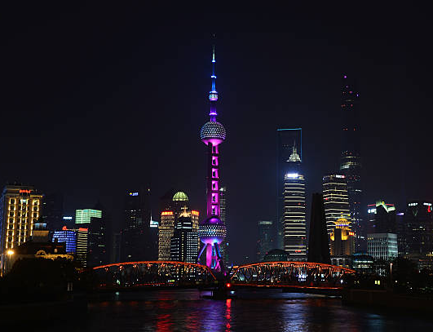
The Legacy of the Cultural Revolution
China’s New Direction
Rejection of Mao’s revolutionary policies
Fast economic growth powered by the four modernizations
Strong emphasis on political stability
Tian An'men Square (June 4th, 1989)
Question Review
How did the Cultural Revolution end and why did it end when it did?
Who was “officially” responsible for the cultural revolution and why?
Whose vision of China won out, Mao’s or his opponents?

